Slide 3
Agenda
Intro and Welcome
Annual Report and Member’s Meeting
Industry Update and Year Ahead
Karen Morgan Comedy
Closing

Slide 4
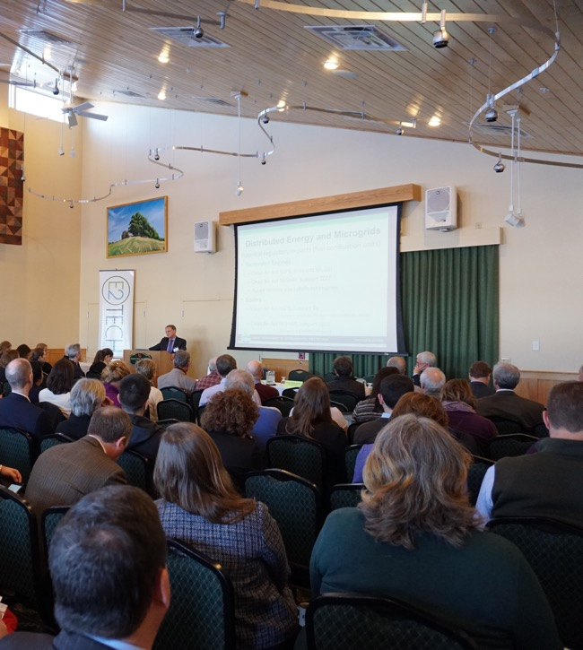
Maine’s Cleantech Business Hub
100 SUPPORT ORGANIZATIONS
280 MEMBER COMPANIES
1700 BUSINESS, NONPROFIT, GOVERNMENT & EDUCATIONAL PROFESSIONALS

Slide 5
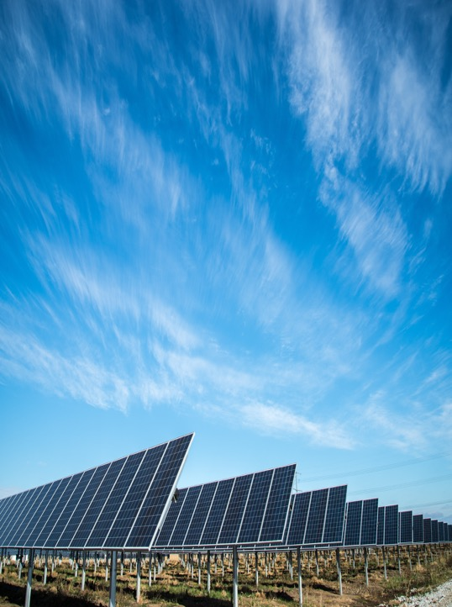
What We Do
CONVENER PUBLIC / PRIVATE / NONPROFIT
CATALYST FOR GROWTH INNOVATION / ECONOMIC & BUSINESS
CREDIBLE RESOURCE OBJECTIVE / NON-PARTISAN / DATA-DRIVEN
CONNECTOR PARTNERS / INFORMATION / BUSINESS RESOURCES

Slide 6
Mission Statement
We seek to build and expand the State's environmental, energy, and clean technology sectors. E2Tech acts as a catalyst to stimulate growth. We facilitate networking, serve as a clearinghouse for objective information, and lead efforts to promote industries and organizations in the sector.

Slide 7
DEI Statement
Everyone deserves access to opportunities and life outcomes that are not determined by race, ethnicity, socioeconomic status, place of origin, religion, gender, sexual orientation, or disability. Unlocking the potential of Maine’s cleantech economy is served by diversity, equity, and inclusion in hiring, training, and promotion, thereby increasing awareness, knowledge, and skills in the workforce.
E2Tech will use the power of our network of businesses, institutions, and individuals as a catalyst to increase employment of diverse professionals and students in the renewable energy and environmental sustainability sectors. We will also work to increase the diversity of the E2Tech membership, Board of Directors, Committees, and programs.

Slide 8
SUSTAINING CHAMPION

Slide 9
SUSTAINING LEADERS

Slide 10
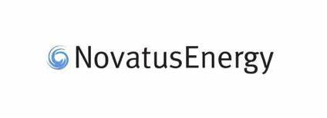
SUSTAINING STEWARDS

Slide 11
Thank you to our Annual Partners!

Slide 14
THANKS FOR BEING A MEMBER!
Our mission is more important than ever, and your support makes it possible
E2Tech events are always free for public officials
Legislators, municipal officials, mayors, & city councilors
E2Tech events are always free for students.
Please use E2Tech in social media, we are E2TechMaine on
Twitter
Facebook
Instagram

Slide 15
Year in Review

Slide 16
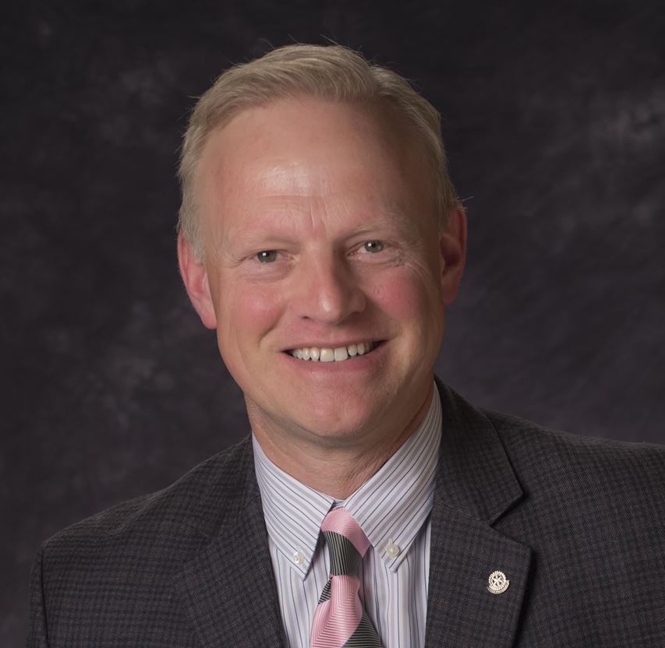
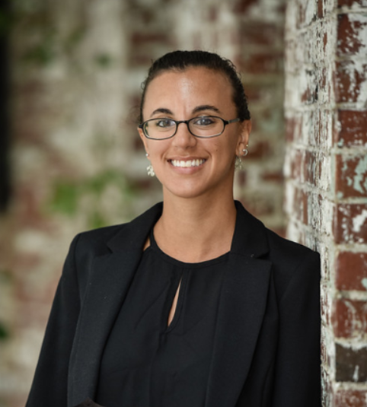
Staff
Marty Grohman,
Executive Director
Adelaide Taylor,
Project Administrator

Slide 17
Annual Revenue

Slide 18
E2Tech welcomed 85 NEW MEMBERS this year!

Slide 19
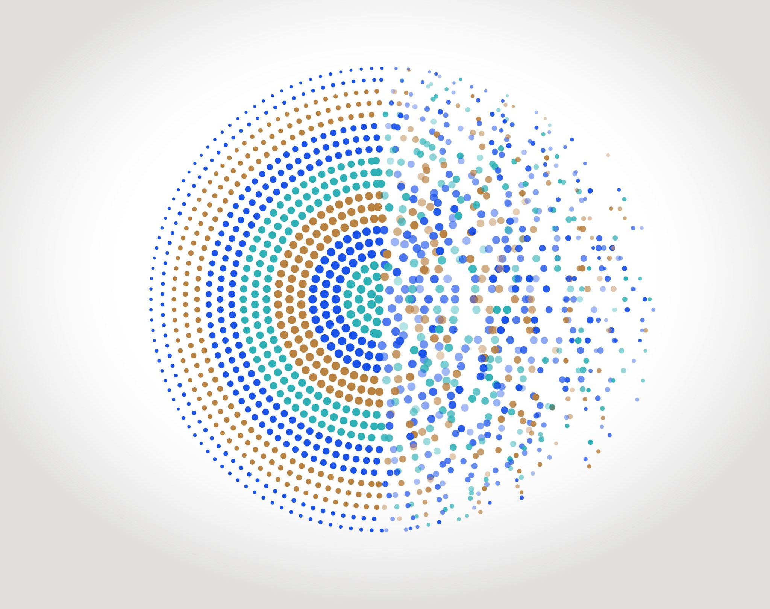
144 MEMBERS renewed their memberships with E2Tech

Slide 20
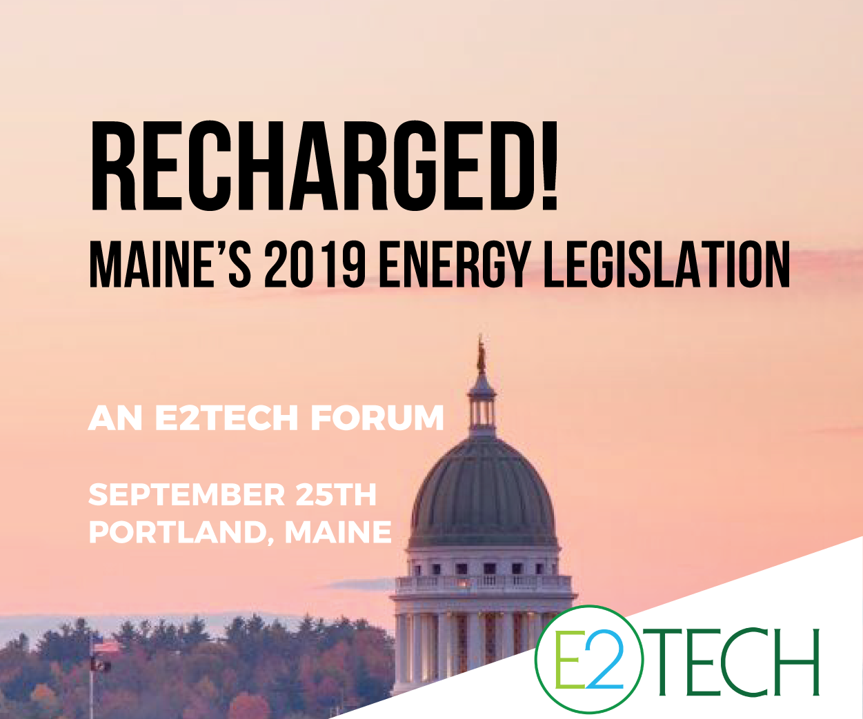
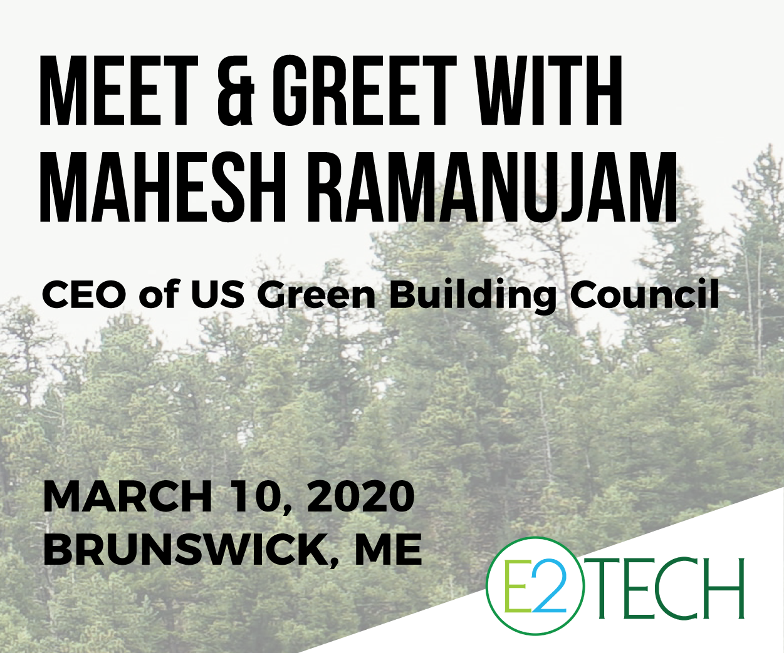
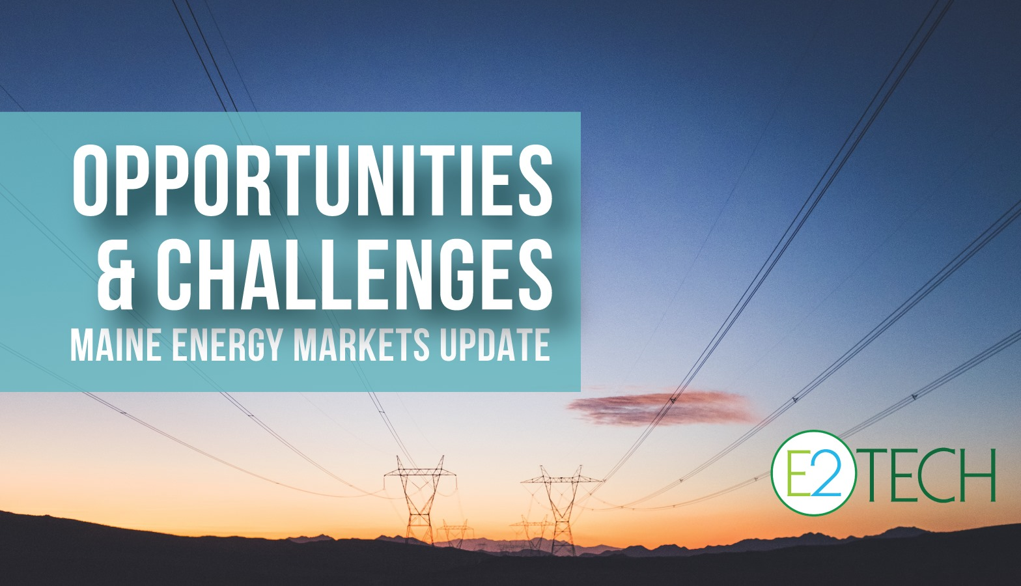
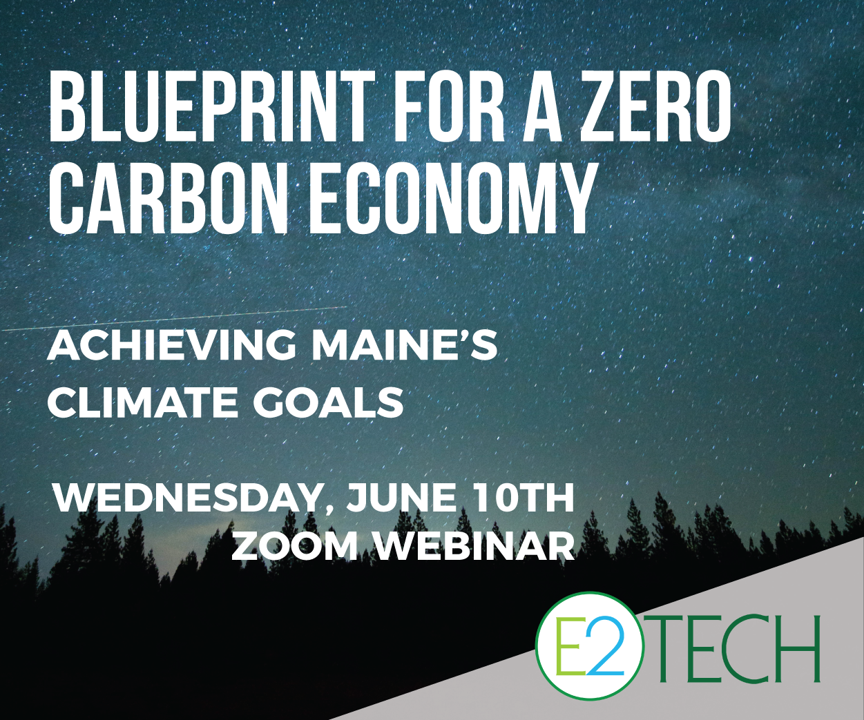
FY 2020 in event logos
Epic Summer Rooftop Social
July 24, 2019
Legislative Clean Energy Luncheon
Achieving Maine’s Climate Goals

Slide 21
Events Review
DATE & EVENT | LOCATION | # REGISTERED
July 24, 2019: Summer Networking Reception 2019 | PORTLAND | 185
Sept 25, 2019: Recharged! Maine's 2019 Energy Legislation | PORTLAND | 249
Nov 6, 2019: Climate Ain't all That's Changing - 2019 Maine Environmental Policy Update | AUGUSTA | 134
Dec. 4, 2019: Winter Social | SOUTH PORTLAND | 128
Jan 28, 2020: Legislative Luncheon | AUGUSTA | 49
Feb 6, 2020: Non-Wires Alternatives | AUGUSTA | 149
Mar 10, 2020: US GBC Meet & Greet - Mahesh Ramanujam | BRUNSWICK | 73
Mar 19, 2020: CleanTeach Open Mixer | VIRTUAL | 109
April 22, 2020: Achieving Maine's Climate Goals - How Do We Get There From Here? | VIRTUAL | 142
May 13, 2020: Opportunities & Challenges: Maine Energy Markets Update | VIRTUAL | 170
June 10, 2020: Blueprint for a Zero Carbon Economy: Achieving Maine's Climate Goals | VIRTUAL | 228

Slide 22
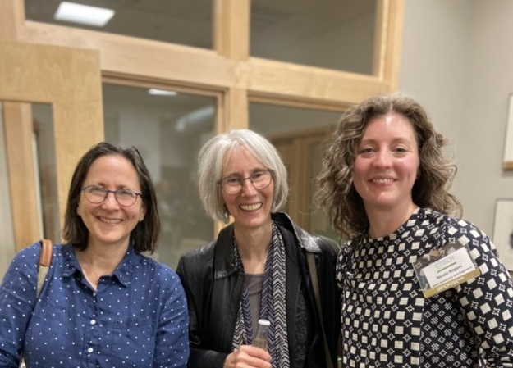
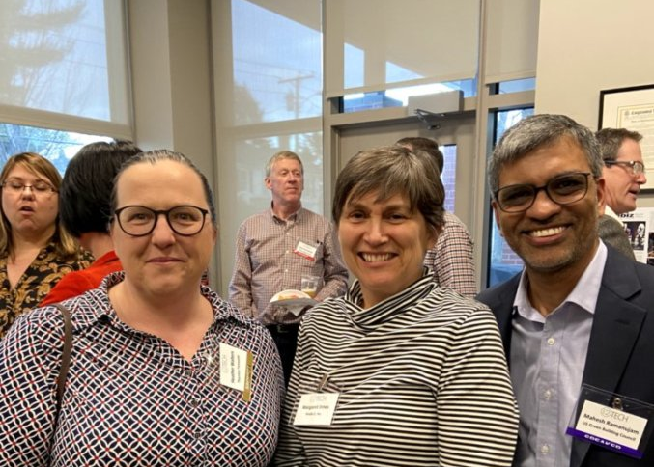

Slide 24
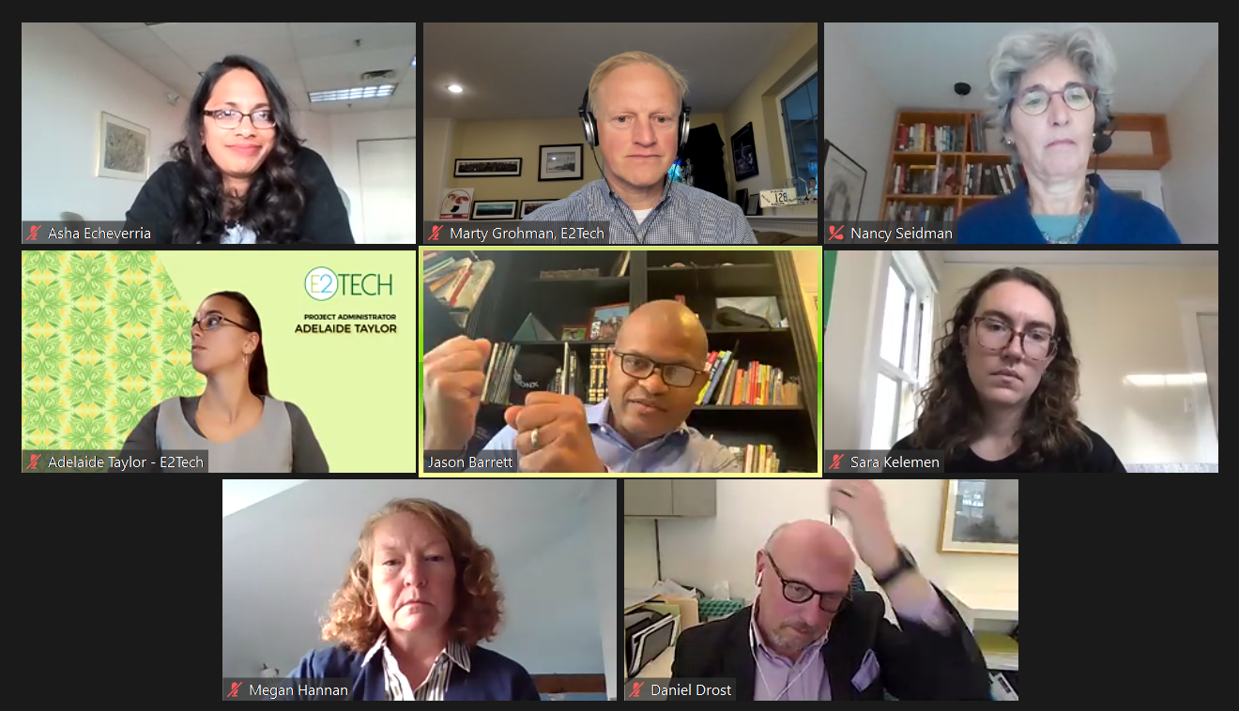

Slide 26
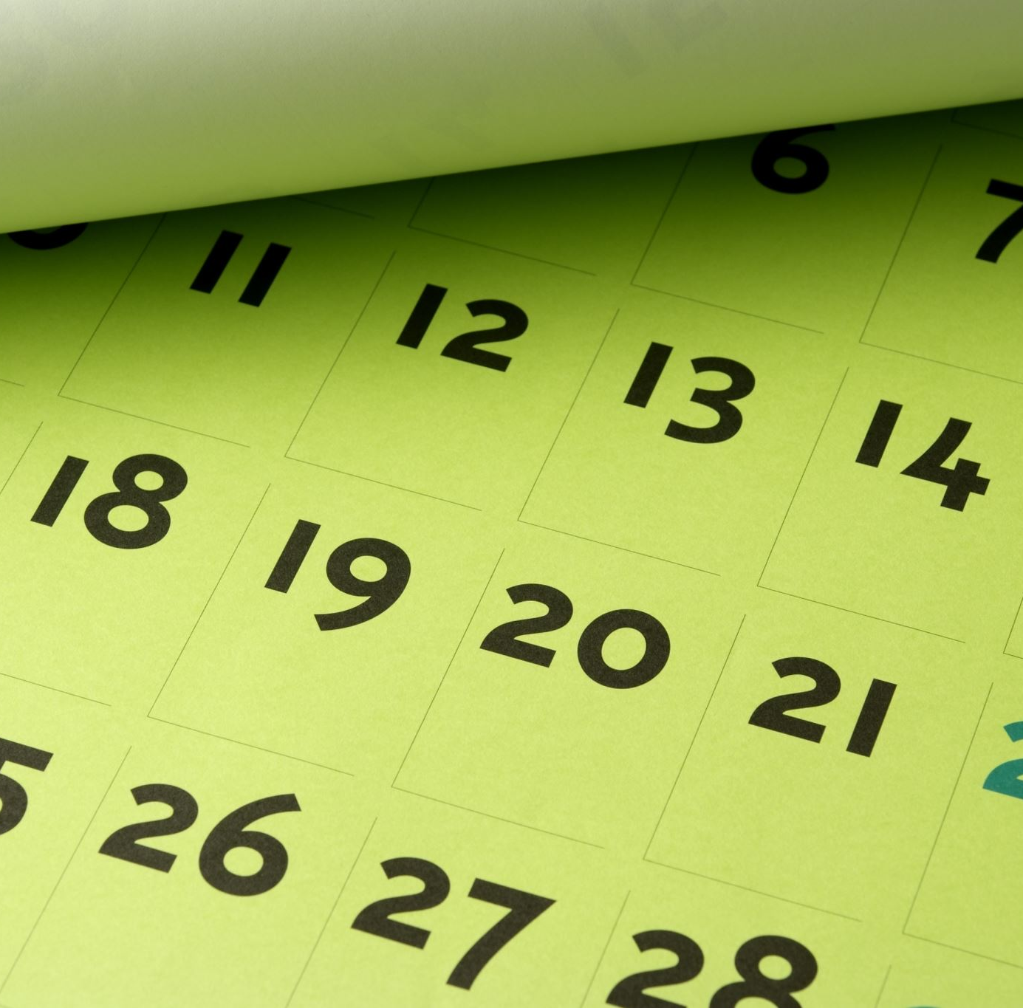
Upcoming Events Calendar
E2Tech Connects 12/17: The NEB & DG Procurement Reports Q&A, with Mitch Tannenbaum & Angela Monroe of Maine PUC
January: Legislative Session Ahead and NECEC Clean Energy Day
Feb: Sludge Spreading & PFAS
Mar/Apr: Beekeeping and Pollinators (tentative); EV Infrastructure (tentative)

Slide 27
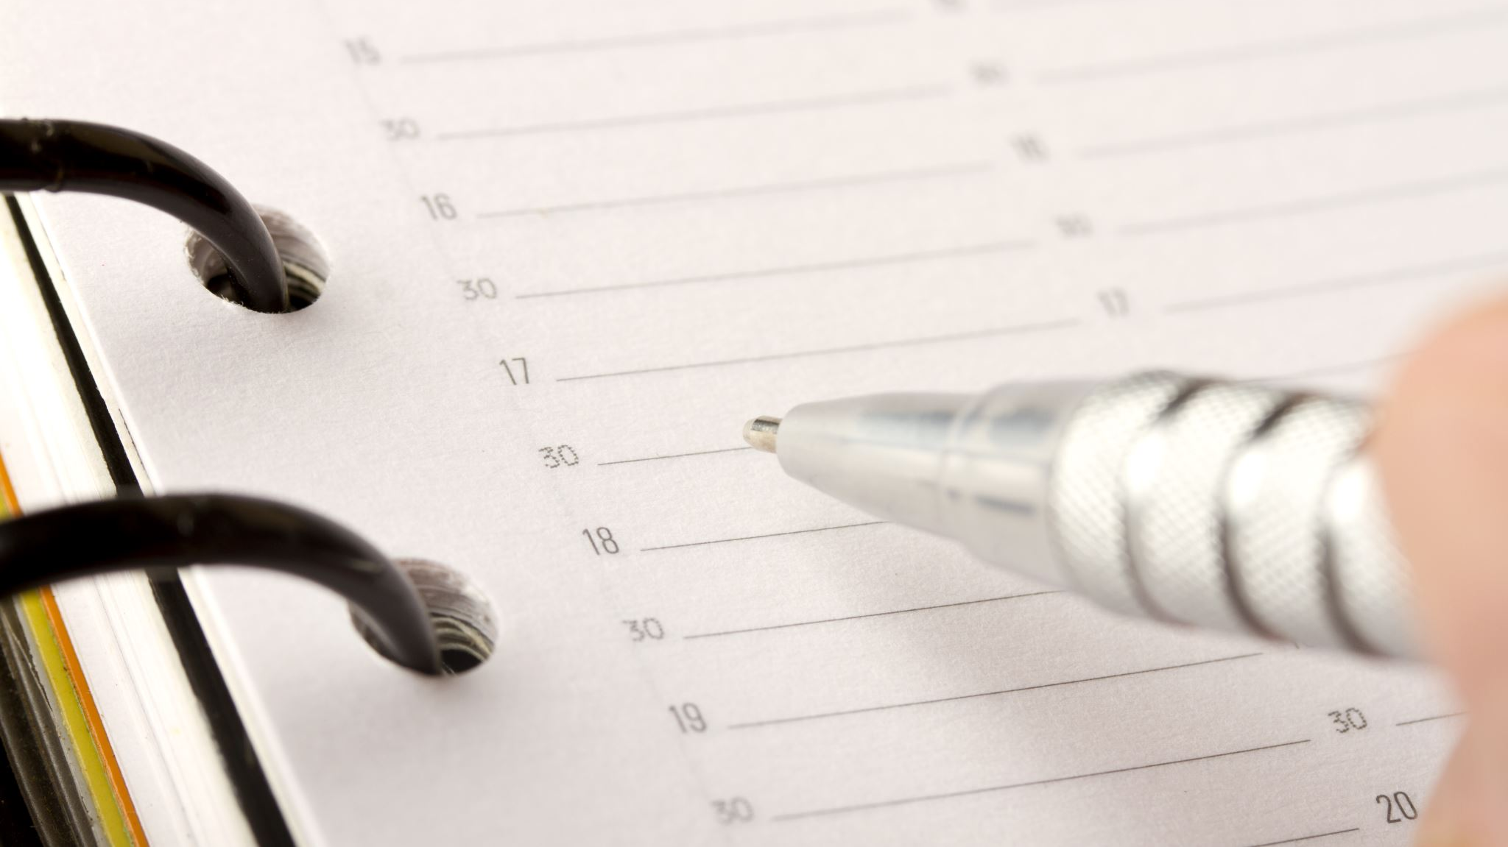
Annual Meeting
Tom Eschner, Board Chair

Slide 28
2018-2021 | 2019-2022 | 2020-2023
Brooke Barnes Stantec | Erik Clapp Sevee & Maher Engineers | David Ertz DBE Consulting
Bill Ferdinand Eaton Peabody | John Carroll | Becky Metivier Tyler Technologies, Inc.
Tim Soley East Brown Cow Management | Phil Coupe ReVision Energy | Sarah Watts Tetra Tech
Elizabeth Swain POWER Engineers | Thomas Eschner TRC | Sarah Tracy Pierce Atwood
Steve Westra CACI Inc. | Michael Stoddard Efficiency Maine | Laney Brown Avangrid
Chris Rauscher SunRun | Jeff Marks Acadia Center | Paul Williamson Walden Renewables
Benji Borowski Preti Flaherty
*Jeff Thaler University of Maine
*John Ferland ORPC
*Jim Katsiaficas Perkins Thompson
E2Tech Board of Directors FY2020

Slide 29
E2Tech Member Vote
E2Tech Board Members Up for Renewal - 3 Year Term:
David Ertz - DBE Consulting
Becky Metivier - Tyler Technologies Inc
Sarah Watts - Tetra Tech
Sarah Tracy - Pierce Atwood
Laney Brown - Avangrid
Paul Williamson - Walden Renewables
E2Tech Board Members Up for Renewal - 1 Year Term:
John Ferland - ORPC
Jim Katsiaficas - Perkins Thompson
Jeff Thaler - University of Maine

Slide 30
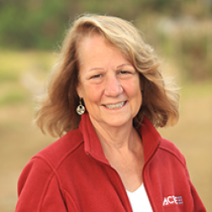
E2Tech Member Vote New Board Member Candidates:
Ellen Belknap,
SMRT Architects & Engineers
Suzanne Watson,
ACEEE

Slide 31
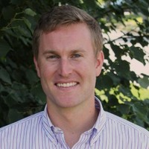
Additions to Program Committee
Sara Kelemen,
University of Maine
Peter Mohlin,
St. Germain

Slide 32
Industry Thoughts & Trends

Slide 33
Environmental
PFAS/Sludge
Dredging and Confined Aquatic Disposal
Commercial Biofuels
Offshore Wind is where it’s at
New funding at GEO
New RFP for stakeholder engagement is due Friday

Slide 34
What’s New in Renewables
Storage Commission was convened by Maine Legislature, but work was lost due to pandemic adjournment
Permitting/Regulatory Streamlining?
Improvements to DG Procurement?
Changes to Net Energy Billing?
Microgrid legislation was at 1-yard line in last session… will be reintroduced
Excise tax structure on larger DG projects, to clarify property tax exemption?
Grid modernization stakeholder process recommended by Maine Climate Council
Regional collaboration?

Slide 35
Release of Four Year Climate Action Plan
Green bank?
Increased RPS Procurement?
EV’s and Charging Stations
Community Solar
No credit check
Flexible commitment
Efforts to reduce Soft costs?
The solar coaster, gold rush mentality
Get as many projects in as you can while you can
Build, sell, move on
“Maine has a last-mover advantage”

